Slide 1
From Berlin back to Business
OPEN ACCESS @ Stellenbosch University Library and Information Service
Mimi Seyffert
Manager: Digitisation and Digital Services
27 July 2015

Slide 2
SUNScholar: Institutional Repository
Peer-reviewed research output:
theses, dissertations, articles, conference proceedings
DSpace open source software

Slide 3
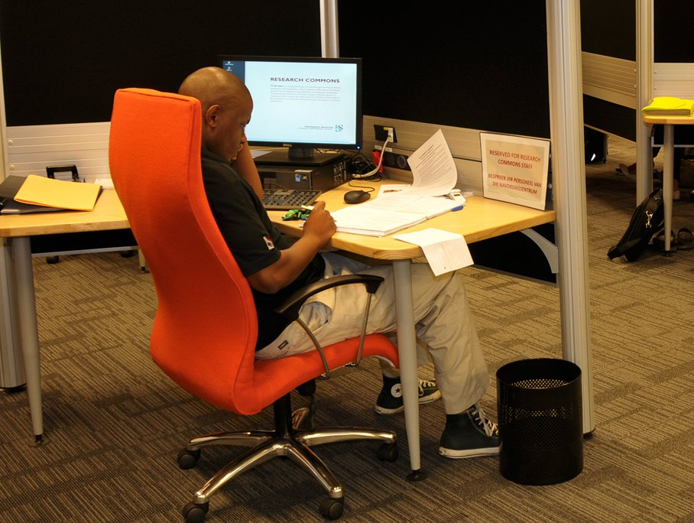
SUNScholar: Institutional Repository
Trend
Collaboration
Value
Making own content available
Retrospective digitisation
Metadata librarians
Faculty librarians
Division of Research Development
Enhances visibility of SU research output
Access to content empowers research and teaching & learning at institution

Slide 4
SUNDigital Collections: Digital Heritage Repository
Unique collections held by the Library
Primary resources
Copyright Stellenbosch University

Slide 5
SUNDigital Collections: Digital Heritage Repository
Trend
Collaboration
Value
Special Collections distinguishes libraries
Making own content available
Metadata librarians
Special Collections librarians
Archival community
Faculties and Departments
Makes valuable primary resource material openly available
Encourages new forms of engagement with material
Preserves original material

Slide 7
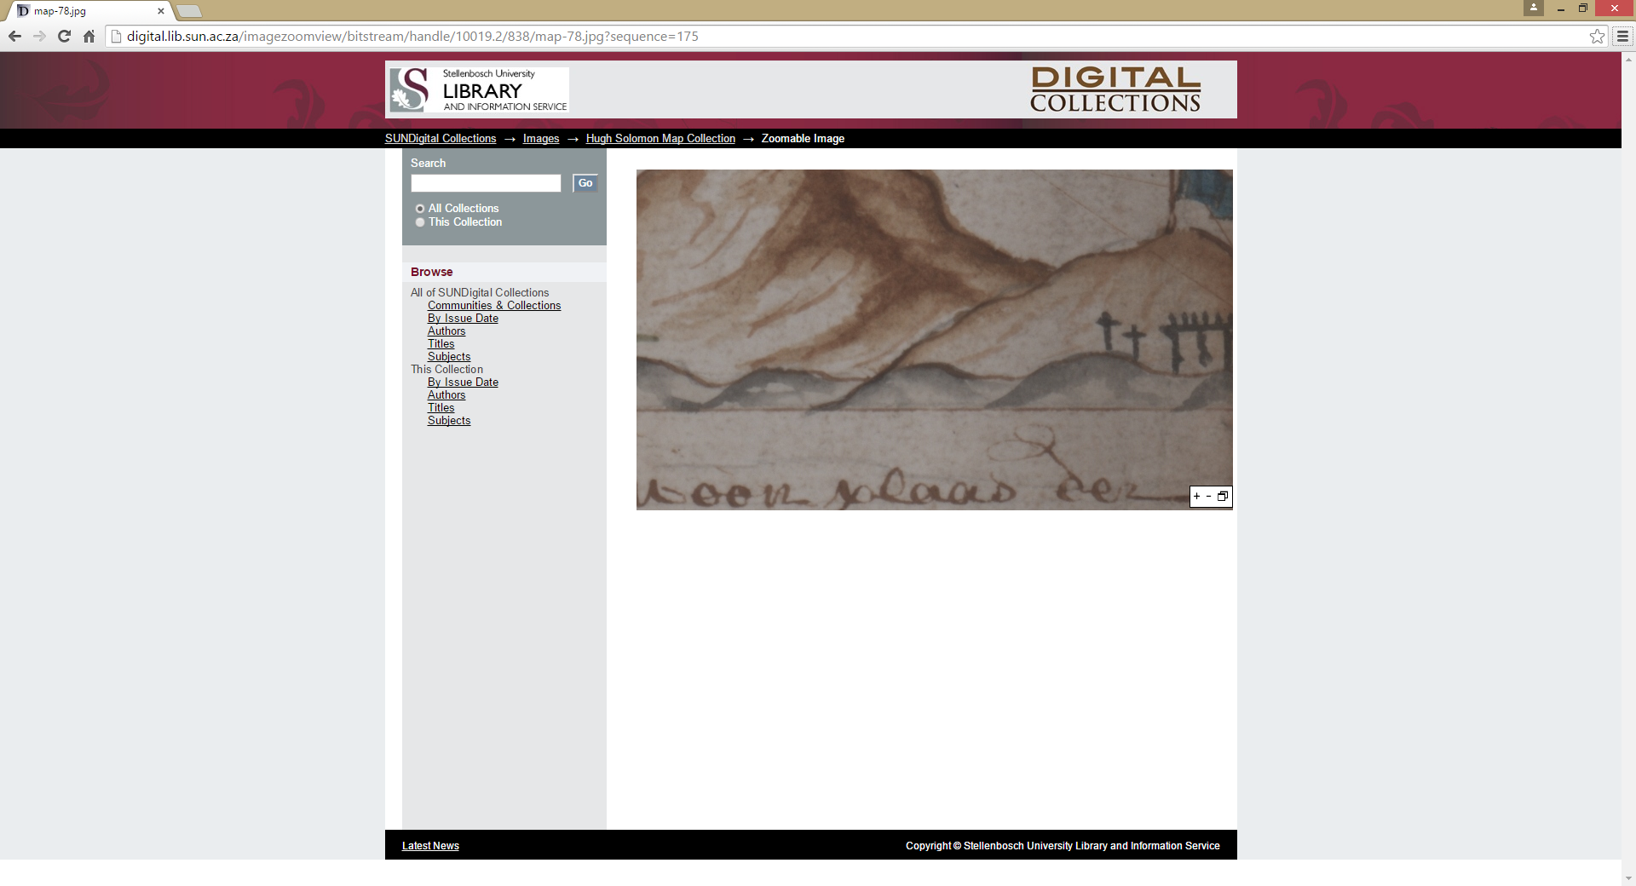

Slide 8
SUNJournals: OA Journal hosting platform
Powered by Open Journals System
20 titles, 18 accredited
Free service for journals with Stellenbosch University affiliation

Slide 9
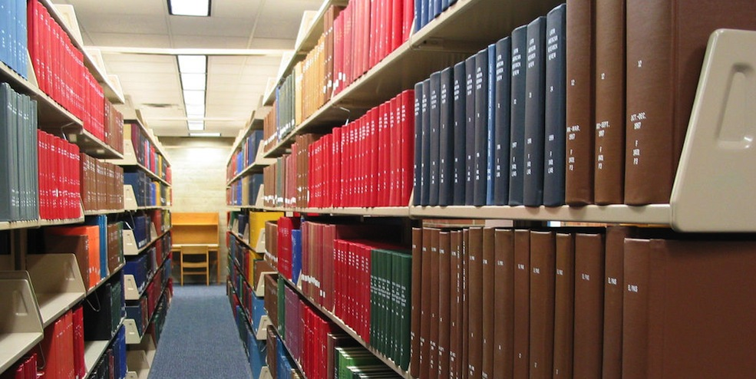
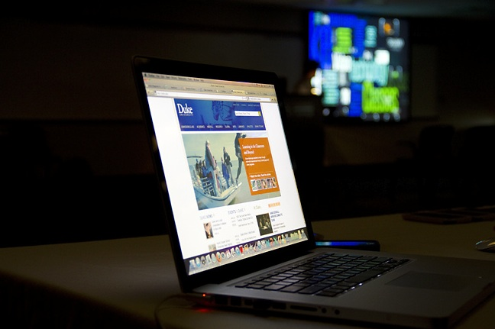
SUNJournals: OA Journal hosting platform
Trend
Collaboration
Value
Library’s role in scholarly communication process
Editors
Authors
Journal managers
Enhances visibility of SU research output
Support
Cost saving
Simple, manageable workflows

Slide 10
Open Access publication fund
Support researchers publishing in OA journals
Subsidising author fees
Strengthen and support institutional OA mandate
Expose authors to OA publishing
Institutional memberships with OA publishers (e.g. BioMed Central)
213 articles since inception of fund in 2009

Slide 11
Policy on self-archiving of research output
AIMS
Increase access to SU research output
Increase visibility of research publications
Create quality metadata to enhance visibility
Ensure preservation of research output
Contribute to the body of research content available through OA

Slide 12
Policy on self-archiving of research output
AUTHORS
Authors with SU affiliation to deposit full text of peer-reviewed published journal article or post print in repository (in compliance with publisher policy)
LIBRARY
Manage submissions on repository
Address copyright and related issues
Create metadata
Ensure that submissions are harvested
Ensure long-term preservation

Slide 13
Policy on self-archiving of research output
HOW TO DEPOSIT
Register as submitter on repository
Faculty librarian submits on behalf of author
Library extracts and uploads full-text where possible (e.g. SUNJournals; research report)

Slide 14
Policy on self-archiving of research output
CHALLENGES
Uncertainty regarding version of article that may be uploaded
Fear of copyright infringement
Lack of understanding OA
Communication
Management of workflows / workload

Slide 15
Policy on self-archiving of research output
Trend
Collaboration
Value
Self-archiving of research output
Repository showcases institution’s research output
Funders’ requirements
Authors / researchers
Faculties and Departments
Division of Research Development
Faculty librarians
Metadata librarians
Enhances visibility of SU research output
Enhances access to SU research output
Strengthens OA
Preservation

Slide 16
Thank you!

