Slide 1
Policy driving Open Access to research
NMMU Open Access Seminar
Ina Smith
27 July 2015

Slide 2
Agenda
Berlin Declaration
What is “policy”?
Why “Open Access policy”?
Status of Open Access policies
Open Access at ASSAf
Open Access policy for a higher education institution

Slide 3
Berlin Declaration
BBB – Budapest Open Access Initiative, Bethesda Statement, Berlin Statement
Berlin = 516 (17 SA)
Active commitment
Two conditions …..
Notes:
Budapest Open Access Initiative put it: "There are many degrees and kinds of wider and easier access to this literature. By 'open access' to this literature, we mean its free availability on the public internet, permitting any users to read, download, copy, distribute, print, search, or link to the full texts of these articles, crawl them for indexing, pass them as data to software, or use them for any other lawful purpose, without financial, legal, or technical barriers other than those inseparable from gaining access to the internet itself. The only constraint on reproduction and distribution, and the only role for copyright in this domain, should be to give authors control over the integrity of their work and the right to be properly acknowledged and cited."
Here's how the Bethesda and Berlin
Establishing open access as a worthwhile procedure ideally requires the active commitment of each and every individual producer of scientific knowledge and holder of cultural heritage. Open access contributions include original scientific research results, raw data and metadata, source materials, digital representations of pictorial and graphical materials and scholarly multimedia material.
Open access contributions must satisfy two conditions:The author(s) and right holder(s) of such contributions grant(s) to all users a free, irrevocable, worldwide, right of access to, and a license to copy, use, distribute, transmit and display the work publicly and to make and distribute derivative works, in any digital medium for any responsible purpose, subject to proper attribution of authorship (community standards, will continue to provide the mechanism for enforcement of proper attribution and responsible use of the published work, as they do now), as well as the right to make small numbers of printed copies for their personal use.
A complete version of the work and all supplemental materials, including a copy of the permission as stated above, in an appropriate standard electronic format is deposited (and thus published) in at least one online repository using suitable technical standards (such as the Open Archive definitions) that is supported and maintained by an academic institution, scholarly society, government agency, or other well-established organization that seeks to enable open access, unrestricted distribution, inter operability, and long-term archiving.
Establishing open access as a worthwhile procedure ideally requires the active commitment of each and every individual producer of scientific knowledge and holder of cultural heritage. Open access contributions include original scientific research results, raw data and metadata, source materials, digital representations of pictorial and graphical materials and scholarly multimedia material.
Open access contributions must satisfy two conditions:The author(s) and right holder(s) of such contributions grant(s) to all users a free, irrevocable, worldwide, right of access to, and a license to copy, use, distribute, transmit and display the work publicly and to make and distribute derivative works, in any digital medium for any responsible purpose, subject to proper attribution of authorship (community standards, will continue to provide the mechanism for enforcement of proper attribution and responsible use of the published work, as they do now), as well as the right to make small numbers of printed copies for their personal use.
A complete version of the work and all supplemental materials, including a copy of the permission as stated above, in an appropriate standard electronic format is deposited (and thus published) in at least one online repository using suitable technical standards (such as the Open Archive definitions) that is supported and maintained by an academic institution, scholarly society, government agency, or other well-established organization that seeks to enable open access, unrestricted distribution, inter operability, and long-term archiving.

Slide 4
Berlin Declaration (1)
“The author(s) and right holder(s) of such contributions grant(s) to all users a free, irrevocable, worldwide, right of access to, and a license to copy, use, distribute, transmit and display the work publicly and to make and distribute derivative works, in any digital medium for any responsible purpose, subject to proper attribution of authorship …”
Notes:
Budapest Open Access Initiative put it: "There are many degrees and kinds of wider and easier access to this literature. By 'open access' to this literature, we mean its free availability on the public internet, permitting any users to read, download, copy, distribute, print, search, or link to the full texts of these articles, crawl them for indexing, pass them as data to software, or use them for any other lawful purpose, without financial, legal, or technical barriers other than those inseparable from gaining access to the internet itself. The only constraint on reproduction and distribution, and the only role for copyright in this domain, should be to give authors control over the integrity of their work and the right to be properly acknowledged and cited."
Here's how the Bethesda and Berlin
Establishing open access as a worthwhile procedure ideally requires the active commitment of each and every individual producer of scientific knowledge and holder of cultural heritage. Open access contributions include original scientific research results, raw data and metadata, source materials, digital representations of pictorial and graphical materials and scholarly multimedia material.
Open access contributions must satisfy two conditions:The author(s) and right holder(s) of such contributions grant(s) to all users a free, irrevocable, worldwide, right of access to, and a license to copy, use, distribute, transmit and display the work publicly and to make and distribute derivative works, in any digital medium for any responsible purpose, subject to proper attribution of authorship (community standards, will continue to provide the mechanism for enforcement of proper attribution and responsible use of the published work, as they do now), as well as the right to make small numbers of printed copies for their personal use.
A complete version of the work and all supplemental materials, including a copy of the permission as stated above, in an appropriate standard electronic format is deposited (and thus published) in at least one online repository using suitable technical standards (such as the Open Archive definitions) that is supported and maintained by an academic institution, scholarly society, government agency, or other well-established organization that seeks to enable open access, unrestricted distribution, inter operability, and long-term archiving.
Establishing open access as a worthwhile procedure ideally requires the active commitment of each and every individual producer of scientific knowledge and holder of cultural heritage. Open access contributions include original scientific research results, raw data and metadata, source materials, digital representations of pictorial and graphical materials and scholarly multimedia material.
Open access contributions must satisfy two conditions:The author(s) and right holder(s) of such contributions grant(s) to all users a free, irrevocable, worldwide, right of access to, and a license to copy, use, distribute, transmit and display the work publicly and to make and distribute derivative works, in any digital medium for any responsible purpose, subject to proper attribution of authorship (community standards, will continue to provide the mechanism for enforcement of proper attribution and responsible use of the published work, as they do now), as well as the right to make small numbers of printed copies for their personal use.
A complete version of the work and all supplemental materials, including a copy of the permission as stated above, in an appropriate standard electronic format is deposited (and thus published) in at least one online repository using suitable technical standards (such as the Open Archive definitions) that is supported and maintained by an academic institution, scholarly society, government agency, or other well-established organization that seeks to enable open access, unrestricted distribution, inter operability, and long-term archiving.

Slide 5
Berlin Declaration (2)
“A complete version of the work and all supplemental materials, including a copy of the permission as stated above, in an appropriate standard electronic format is deposited (and thus published) in at least one online repository using suitable technical standards …”
Notes:
Budapest Open Access Initiative put it: "There are many degrees and kinds of wider and easier access to this literature. By 'open access' to this literature, we mean its free availability on the public internet, permitting any users to read, download, copy, distribute, print, search, or link to the full texts of these articles, crawl them for indexing, pass them as data to software, or use them for any other lawful purpose, without financial, legal, or technical barriers other than those inseparable from gaining access to the internet itself. The only constraint on reproduction and distribution, and the only role for copyright in this domain, should be to give authors control over the integrity of their work and the right to be properly acknowledged and cited."
Here's how the Bethesda and Berlin
Establishing open access as a worthwhile procedure ideally requires the active commitment of each and every individual producer of scientific knowledge and holder of cultural heritage. Open access contributions include original scientific research results, raw data and metadata, source materials, digital representations of pictorial and graphical materials and scholarly multimedia material.
Open access contributions must satisfy two conditions:The author(s) and right holder(s) of such contributions grant(s) to all users a free, irrevocable, worldwide, right of access to, and a license to copy, use, distribute, transmit and display the work publicly and to make and distribute derivative works, in any digital medium for any responsible purpose, subject to proper attribution of authorship (community standards, will continue to provide the mechanism for enforcement of proper attribution and responsible use of the published work, as they do now), as well as the right to make small numbers of printed copies for their personal use.
A complete version of the work and all supplemental materials, including a copy of the permission as stated above, in an appropriate standard electronic format is deposited (and thus published) in at least one online repository using suitable technical standards (such as the Open Archive definitions) that is supported and maintained by an academic institution, scholarly society, government agency, or other well-established organization that seeks to enable open access, unrestricted distribution, inter operability, and long-term archiving.
Establishing open access as a worthwhile procedure ideally requires the active commitment of each and every individual producer of scientific knowledge and holder of cultural heritage. Open access contributions include original scientific research results, raw data and metadata, source materials, digital representations of pictorial and graphical materials and scholarly multimedia material.
Open access contributions must satisfy two conditions:The author(s) and right holder(s) of such contributions grant(s) to all users a free, irrevocable, worldwide, right of access to, and a license to copy, use, distribute, transmit and display the work publicly and to make and distribute derivative works, in any digital medium for any responsible purpose, subject to proper attribution of authorship (community standards, will continue to provide the mechanism for enforcement of proper attribution and responsible use of the published work, as they do now), as well as the right to make small numbers of printed copies for their personal use.
A complete version of the work and all supplemental materials, including a copy of the permission as stated above, in an appropriate standard electronic format is deposited (and thus published) in at least one online repository using suitable technical standards (such as the Open Archive definitions) that is supported and maintained by an academic institution, scholarly society, government agency, or other well-established organization that seeks to enable open access, unrestricted distribution, inter operability, and long-term archiving.

Slide 6
What is “policy”?
“A definite course or method of action selected (by governments, institutions, groups, individuals) from among alternatives and in light of given conditions to guide and determine present and future decisions.”
“A high-level overall plan embracing the general goals and acceptable procedures especially of a governmental body.”
(Merriam-Webster Online Dictionary)

Slide 7
1
Policy = Principles + Objectives + Decisions
Policy = Decision-making framework to achieve a desired outcome, in the interest of a specific community
Policy = Response to the changing world we find ourselves in
Policy needs to be aligned
2
3
4

Slide 8
5
Policy = Followed by procedures, guidelines, processes, planning
Policy = Strategic & long term; Planning = operational within specific timeframes
Policies change, needs to be revisited, adapted in line with change
Policy can be enforced
6
7
8

Slide 9
Stages of Policy Process (John W Kingdon)
Problem Identification
Policy Formulation
Policy Adoption
Policy Implementation
Policy Evaluation
Policy Advisory Committee
Terms of Reference
Notes:
Issue Identification ◦ Publicized demands for government action can lead to identification of policy problems. ◦ Attention that prompts the need for government action.  Agenda Setting ◦ Government begins to give serious consideration

Slide 10
Why “Open Access Policy”?
Principle: Right to access information (Bill of Rights)
Problem: High subscription costs & research funded with tax payer’s money
Objective: To open up access to information funded with tax payer’s money

Slide 11
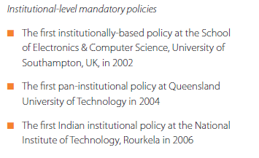
Policy implementations promoting OA

Slide 12
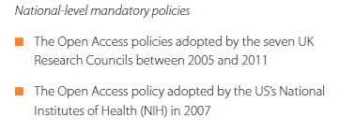
Policy implementations promoting OA

Slide 13
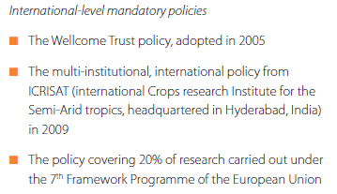
Policy implementations promoting OA

Slide 14
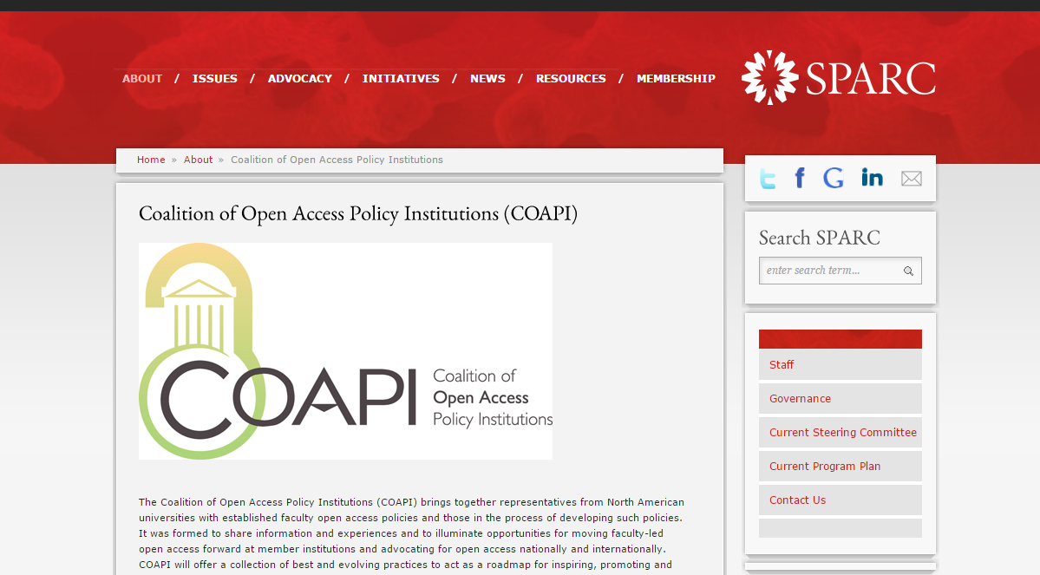
Coalitions eg United States

Slide 15
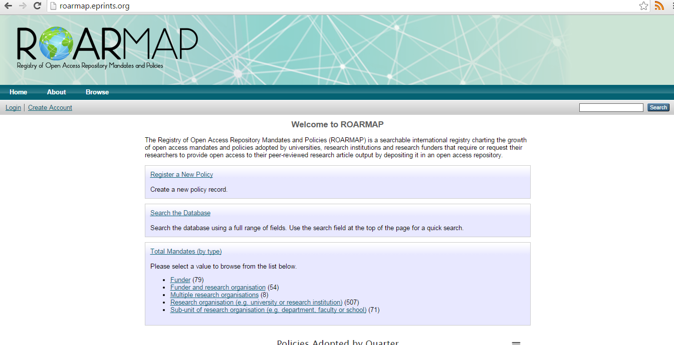
Open Access policies resource
http://roarmap.eprints.org

Slide 16
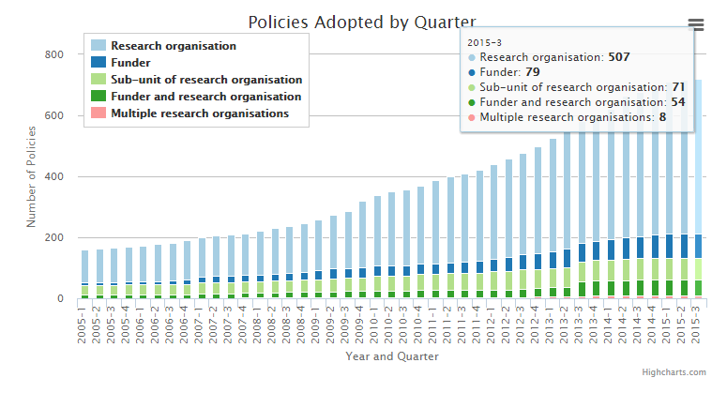
Status of Open Access policies

Slide 17
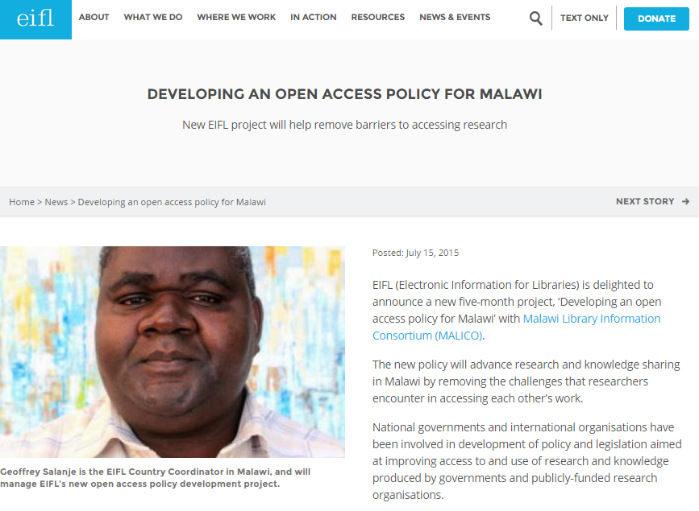
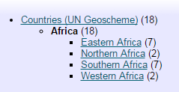
Status of Open Access policies in Africa
Notes:
Botswana, Zambia
EIFL (Electronic Information for Libraries) is delighted to announce a new five-month project, ‘Developing an open access policy for Malawi’ with Malawi Library Information Consortium (MALICO).
The new policy will advance research and knowledge sharing in Malawi by removing the challenges that researchers encounter in accessing each other’s work.
National governments and international organisations have been involved in development of policy and legislation aimed at improving access to and use of research and knowledge produced by governments and publicly-funded research organisations.
However, Malawi does not yet have policy or legislation of this kind.
The new EIFL project aims to develop an open access policy for Malawi that will enhance access to research funded by government and donor agencies, and improve dissemination of research results.
It will help to populate an open access Malawi National Digital Repository developed by MALICO and hosted at the Malawi National Library Services.
The new policy will especially improve scholarly communication and the visibility of research by Malawian researchers and institutions, and will promote development of the Malawian publishing industry.
MALICO will work with the National Commission for Science and Technology (NCST) - the principal body responsible for promoting and coordinating research, science and technology in Malawi.
The project will set up a task force to lead a policy development process that will include consultations, drafting, review, submission of the policy to government for approval, and finally, launching and raising awareness about the new policy. Librarians, policy makers, researchers, teachers, students, publishers and other stakeholders will be involved.
The goals of the new policy will be to:
Improve scholarly communication and advance knowledge;
Enhance collaboration and partnerships among researchers, policy makers, and beneficiaries;
Minimize research duplication of research;
Increase access to knowledge, thereby improving decision-making at all levels of society and contributing to development in Malawi.

Slide 18
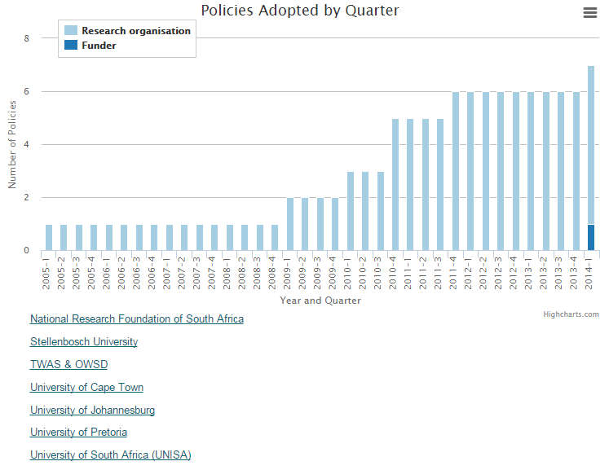
Status of Open Access policies in SA
7

Slide 19
NRF Open Access Statement

Slide 20
NRF Open Access Statement
“From 01 March 2015, authors of research papers generated from research either fully or partially funded by NRF, when submitting and publishing in academic journals, should deposit their final peer-reviewed manuscripts that have been accepted by the journals, to the administering Institution Repository with an embargo period of no more than 12 months.”
+ data sets

Slide 21
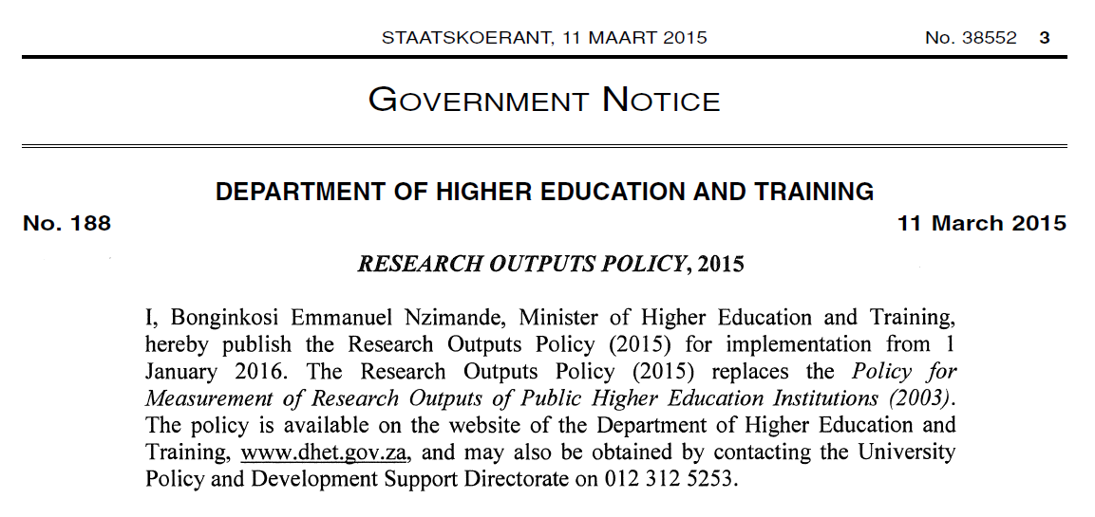
DHET Research Outputs Policy 2015 (funding for accredited journal titles)

Slide 22
DHET Research Outputs Policy 2015 (funding for accredited journal titles)

Slide 23
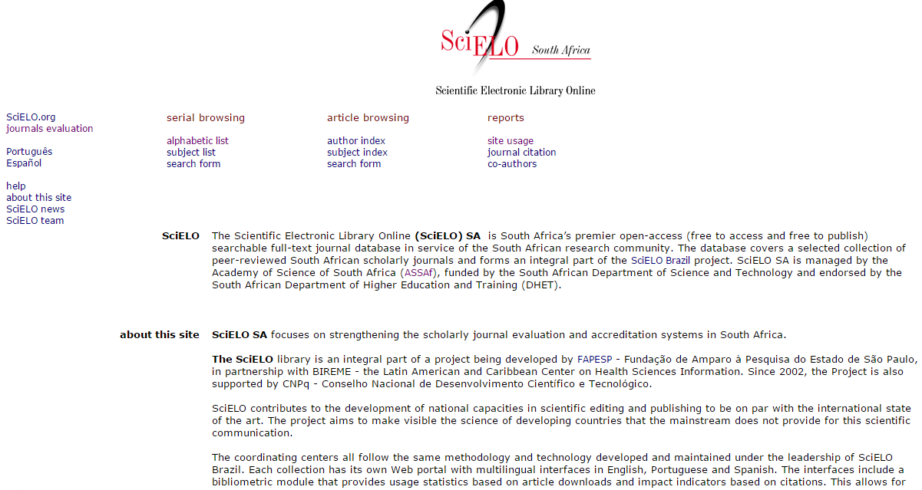
Open Access at ASSAf

Slide 24
UNESCO Open Access Policy Africa initiative
“UNESCO indicated that they are prepared to play a consultative role, and work with African countries interested in working towards a national Open Access policy. It was in this regard that the Academy of Science of South Africa (ASSAf) submitted a letter to Dr Bhanu Neupane, Programme Specialist in Paris, France to express it interest to participate.”
Consultative Forum on Open Access (OA): Towards high level interventions for research and development in Africa
29 & 30 January 2015, Kenya
Notes:
UNESCO, the Network of African Science Academies (NASAC), the Royal Netherlands Academy of Arts and Sciences, the Kenya National Academy of Sciences, the African Academy of Sciences, and the Kenyan Ministry of Education, Sciences and Technology participated in a Consultative Forum on Open Access (OA): Towards high level interventions for research and development in Africa. The two-day consultation, which took place in Nairobi on 29 and 30 January 2015, brought some 45 high-level policy makers and experts representing 20 African countries together.
At this meeting, UNESCO indicated that they are prepared to play a consultative role, and work with African countries interested in working towards a national Open Access policy. It was in this regard that the Academy of Science of South Africa (ASSAf) submitted a letter to Dr Bhanu Neupane, Programme Specialist in Paris, France to express it interest to participate (attached).
Dr Neupane also requested ASSAf to sent you a copy of the request in order to keep you

Slide 25
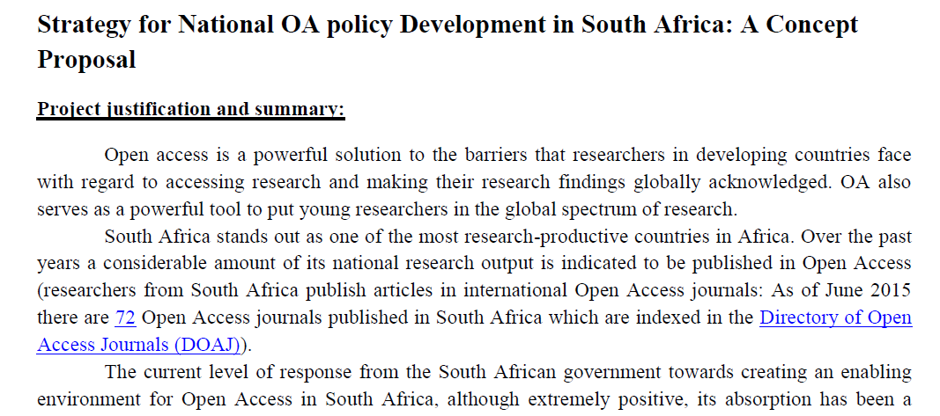
UNESCO Open Access Policy Africa initiative
+ ASSAf CSPiSA
Notes:
UNESCO, the Network of African Science Academies (NASAC), the Royal Netherlands Academy of Arts and Sciences, the Kenya National Academy of Sciences, the African Academy of Sciences, and the Kenyan Ministry of Education, Sciences and Technology participated in a Consultative Forum on Open Access (OA): Towards high level interventions for research and development in Africa. The two-day consultation, which took place in Nairobi on 29 and 30 January 2015, brought some 45 high-level policy makers and experts representing 20 African countries together.
At this meeting, UNESCO indicated that they are prepared to play a consultative role, and work with African countries interested in working towards a national Open Access policy. It was in this regard that the Academy of Science of South Africa (ASSAf) submitted a letter to Dr Bhanu Neupane, Programme Specialist in Paris, France to express it interest to participate (attached).
Dr Neupane also requested ASSAf to sent you a copy of the request in order to keep you

Slide 26
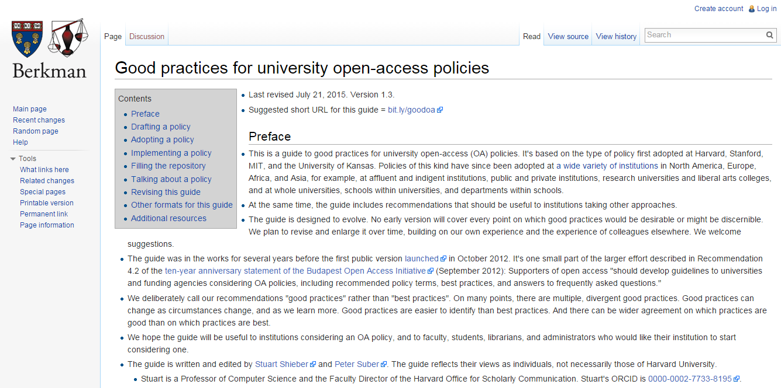
Guidelines to an effective Open Access policy
http://cyber.law.harvard.edu/hoap/Good_practices_for_university_open-access_policies

Slide 27
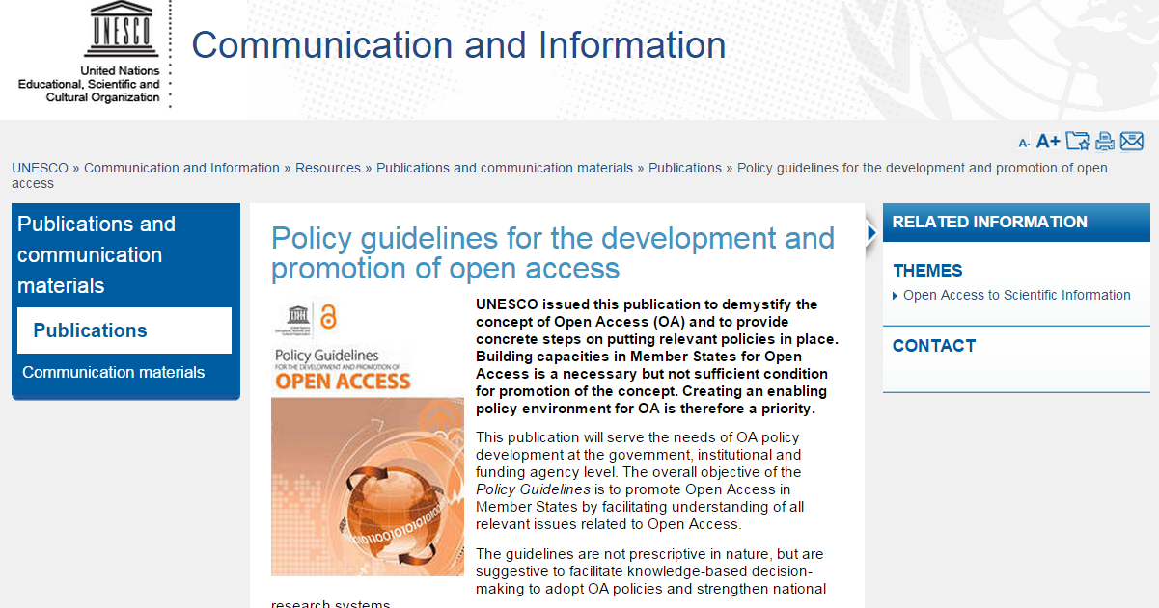
http://www.unesco.org/new/en/communication-and-information/resources/publications-and-communication-materials/publications/full-list/policy-guidelines-for-the-development-and-promotion-of-open-access/

Slide 28
Thank you
ina@assaf.org.za
Planning Manager
Academy of Science of South Africa (ASSAf)

